Slide 1
Arcade Simulation with FPGA Boards
Nick Burek and Thomas griebel
Loras College

Slide 2
The Big Picture
Participating in Digilent Design Contest
Using an FPGA board
The board allows for programmable hardware
Embedded Microprocessor (MicroBlaze)
The board transmits a signal to a VGA monitor in 640x480 resolution
Create an easily programmable arcade system
Capable of running different games by swapping out the source code

Slide 3
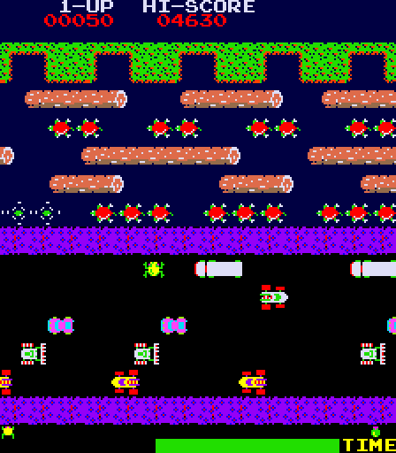
1982 classic Frogger

Slide 4
Project Overview
Management/Software Engineering
Hardware
Hardware/software connection
Software

Slide 5
Management/Software Engineering
Source Control
Used GIT
Divided labor between files
Created tasks and goals
Bi-weekly meetings
Discussed problems and solutions for design
Decided on scope and limitations
Communicated heavily over Skype

Slide 6
Hardware
VHSIC Hardware Description Language (VHDL)
Components
VGA Driver
Joystick Driver
Video RAM Interface

Slide 7
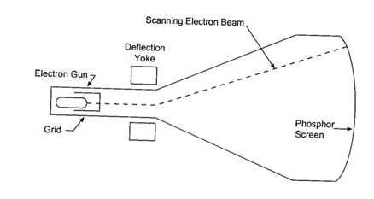
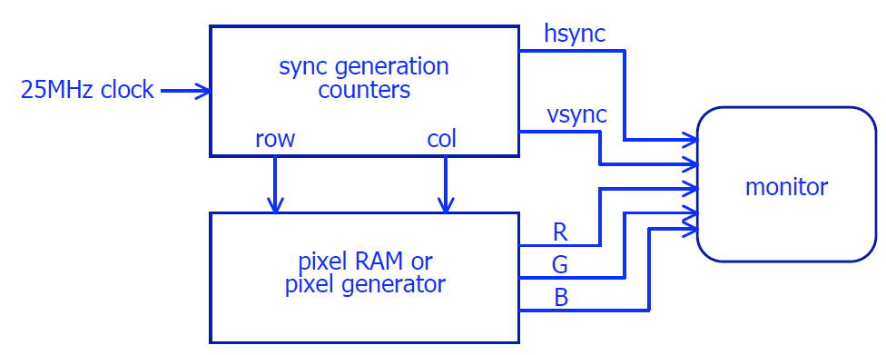
VGA Driver
25 MHz clock
Horizontal and Vertical Sync signals
8 bit color

Slide 8
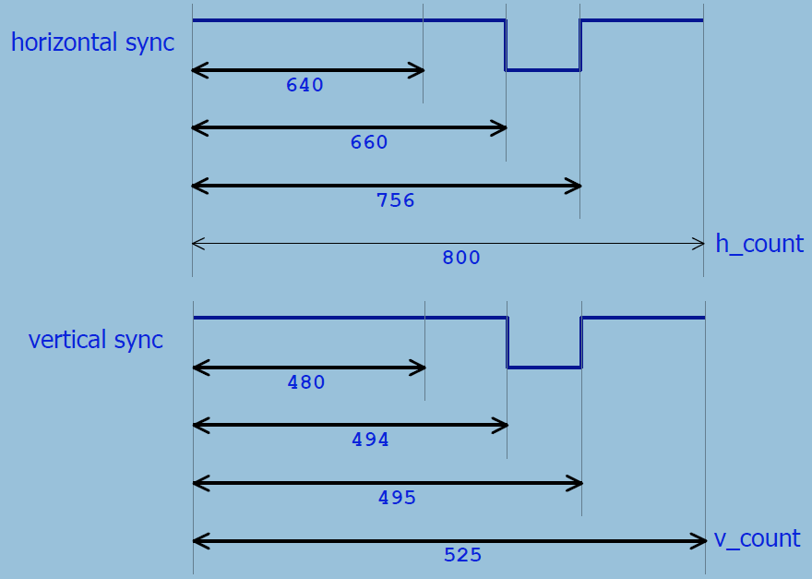
VGA Driver cont.

Slide 9

Joystick Driver
Serial Peripheral Interface (SPI)
5 bytes
2 for X
2 for Y
1 for buttons

Slide 10
Video RAM
On board Block RAM (BRAM) vs. Micron RAM chip
307,200 Bytes – if storing every pixel
Timing Concerns
70 nanosecond read/write time from RAM
40 nanosecond (25 MHz) time between pixel outputs
Would require a cache and a FIFO buffer for writes
7,876 Bytes – if using a tile based system

Slide 11
Hardware/software connection
Tile-based system cache
Inspired by the NES PPU
Screen is divided 80x60 grid
Storage for 64 8x8 tiles
Repetition of tiles dramatically reduces file size
Memory mapped operations
32-bit objects are mapped to hardware
Objects are divided into code segments
The code segments instruct the graphics processor
Microblaze
Creates an actual computer environment to work with

Slide 12
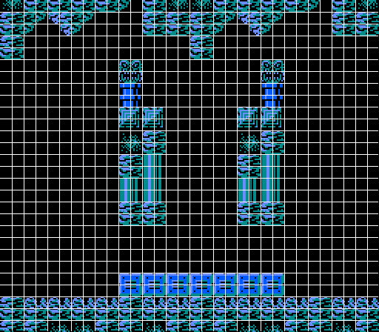
PPU and Tile-based theory

Slide 13
Software
Limited storage (16KB)
Used C to create the logic for the game
C++ used for development tools
Compression
Graphics conversion
Problems
Collisions
Compression
Animations
Graphics

Slide 14
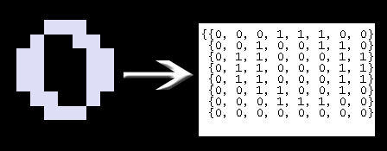
Converting Graphics

Slide 16
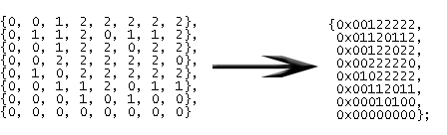
Storage and Space
Memory so limited even instructions set us over
Created innovative ways to pack memory
Graphics are stored in 2D arrays which store color indexes

Slide 17
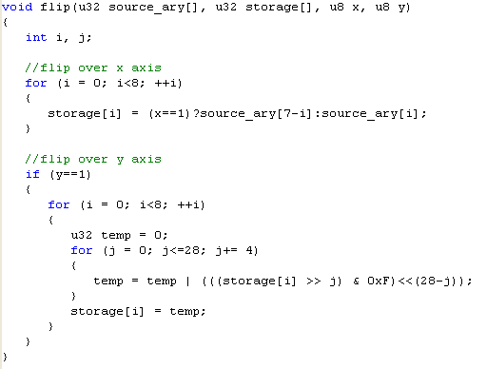
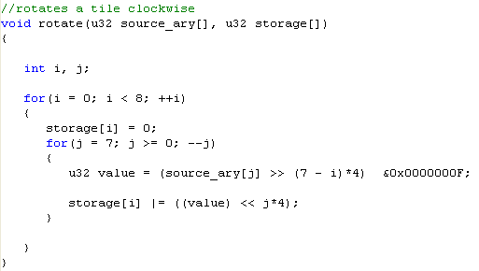
Tile Rotating and Flipping

Slide 18
Conclusion
What we gained from this
Work left to be done
Digilent Design Conference May 6th

